Slide 1

Digital Marketing Project Phase 2
Comprehensive Digital Marketing For Maruti Suzuki India Ltd

Slide 2
Contents of this Presentation
Index
SI NO | Particulars
Chapter One | Brand Study, Competitor Analysis & Buyer’s/Audience’s Persona
Chapter Two | SEO & Keyword Research
Chapter Three | Content Ideas And Marketing Strategies
Chapter Four | Content Creation And Curation
Conclusion | PPT Conclusion
Faculty Guid : K.JAGAN MOHAN
Team Members: Golla Sai Narasimha ,katakam Lakshmi Deepak,Vulsi Lavanya ,Kokkirigadda Kezia

Slide 3

Maruti Suzuki India Ltd!
Maruti Suzuki India Limited is the Indian subsidiary of Japanese automaker Suzuki Motor Corporation.

Slide 4
01
Chapter One
Brand Study, Competitor Analysis & Buyer’s/Audience’s Persona

Slide 5
Research Brand Identity
Mission/Values:
Maruti Suzuki has always underscored the importance of producing reliable and value-for-money vehicles. Their mission and values are built around a few key principles:
Customer Centricity: Ensuring customers get the utmost value and satisfaction from their products.
Innovation: Constantly enhancing their products and services through continuous innovation.
Ethical Conduct: Maintaining transparency and high ethical standards in all of their dealings.
Environmental Responsibility: Creating environmentally-friendly vehicles and upholding sustainable practices.

Slide 6
Research Brand Identity
Unique Selling Proposition (USP):
Affordability: Maruti Suzuki is known for providing cars that are affordable for a large segment of the population.
Reliability: Their vehicles are renowned for their durability and low maintenance costs.
Widespread Service Network: They have one of the most extensive car service networks in India.
Resale Value: Maruti Suzuki cars generally have a high resale value due to their reliability and brand trust.

Slide 7
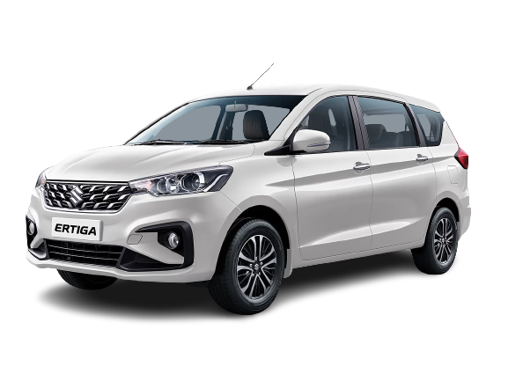
Research Brand Identity
Analyze Brand Messaging:
Maruti Suzuki's brand messaging revolves around being more than just a car manufacturer; they present themselves as a brand deeply embedded in the lives of Indian families. Their communications emphasize trust, reliability, innovation, and understanding the needs of the Indian consumer.

Slide 8

Research Brand Identity
Examine the brand's tagline:
Tagline: "Way of Life"
This tagline suggests that Maruti Suzuki is not just about cars but about an approach to life, resonating with the idea that owning a Maruti Suzuki is a lifestyle choice. The tagline implies reliability, trust, and the integral role the brand plays in the everyday lives of its customers.

Slide 9
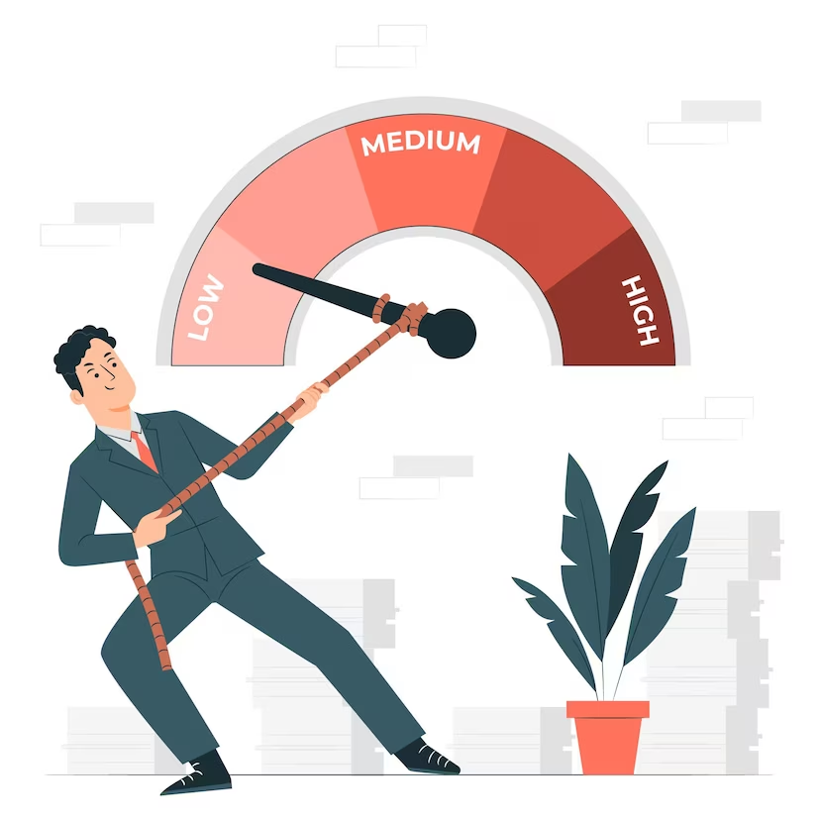




KPI’S
Sales Volume
Market Share
Dealer Performance
Quality Control Fail Rate
Digital Engagement

Slide 10
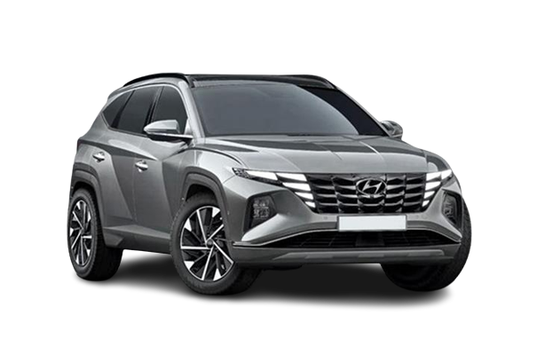
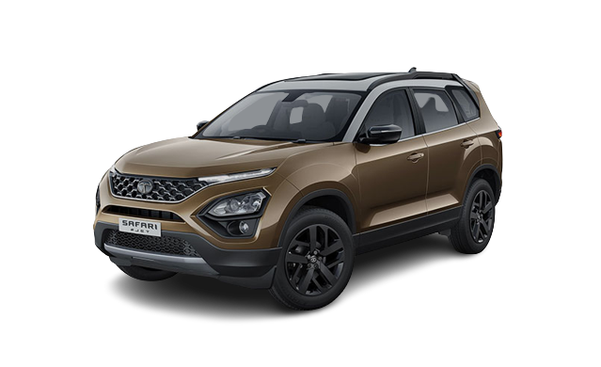
Competitor Analysis
Hyundai Motor India Ltd.
Strengths: Second-largest car manufacturer in India, extensive product range, strong brand presence, and innovative marketing strategies.
Weaknesses: Fewer service centers compared to Maruti Suzuki, slightly higher pricing for some models.
Unique Selling Proposition (USP): Advanced technology, stylish designs, and a strong focus on safety and environmental sustainability.
Major Products: i20, Creta, Verna, Santro.
Tata Motors
Strengths: Strong brand presence in India, diverse product range from cars to trucks, focus on innovation (like electric vehicles).
Weaknesses: Past perceptions of lower build quality, although this has been improving.
USP: "Desi" brand identity (truly Indian), emphasis on safety and performance.
Major Products: Nexon, Tiago, Altroz, Harrier.

Slide 11
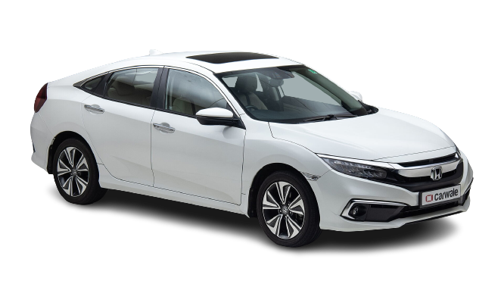
Honda Cars India
Strengths: International brand appeal, known for reliability and build quality, innovative technology.
Weaknesses: Higher price points for some models compared to competitors, limited product range.
USP: Advanced engineering, reliability

Slide 12
SWOT
Strengths:
Global Presence: Hyundai has a strong global footprint and is one of the top automotive brands worldwide.
Product Diversity: Offers a wide range of vehicles from budget to luxury.
Innovation: Has made significant strides in electric and hybrid vehicle technology.
Quality & Design: Consistent focus on quality and attractive car designs.
Weaknesses:
Dependence on Sedan Market: The sedan market has seen a slowdown in certain regions.
Competition: Faces stiff competition from both established and emerging brands.
Opportunities:
Electric and Hybrid Market: Can further tap into the growing demand for electric and hybrid vehicles.
Emerging Markets: Expansion opportunities in developing countries.
Threats:
Fluctuating Global Economies: Economic downturns impact car sales.
Regulatory Changes: Increasing emissions standards worldwide.
Strengths:
Domestic Presence: Strong foothold in the Indian market.
Diverse Portfolio: From cars to commercial vehicles.
Innovative Models: Recent models like Nexon and Harrier have been well-received.
R&D Capabilities: Significant investment in research and development.
Weaknesses:
Global Presence: Limited as compared to some other global players.
Past Models: Older models had faced quality and reliability issues.
Opportunities:
Electric Vehicles: Tata is focusing on electric vehicles with models like Nexon EV.
Export Markets: Expand its presence in other developing nations.
Threats:
Intense Competition: Especially in the domestic market from both international and local players.
Economic Instability: Especially in the home market, India.

Slide 13
Strengths:
Brand Reputation: Known for reliability and durability.
Engineering Excellence: High-performance engines and innovative tech.
Diverse Range: From budget vehicles to luxury models and motorcycles.
Global Network: Strong presence in both western and Asian markets.
Weaknesses:
Limited Electric Offerings: Compared to some competitors, their electric vehicle range is limited.
Dependence on North American Market: A significant portion of sales come from this region.
Opportunities:
Hybrid & Electric Market: Expand and innovate in this rapidly growing segment.
Emerging Markets: Further expansion in regions like Africa.
Threats:
Competitive Pressure: From both traditional car manufacturers and new entrants.
Regulations: Stringent emission regulations worldwide.
Please note that this analysis is a general overview, and the specifics might vary based on region, time, and changing business dynamics.

Slide 14
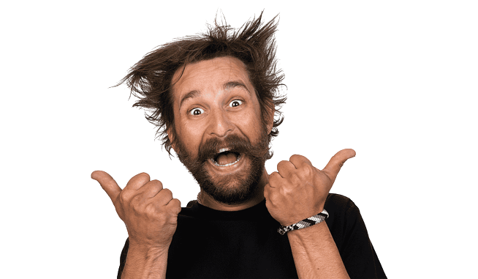
Buyer's/Audience's Persona
Persona Name: Ramesh
Demographics:
Age: 30-40 years
Gender: Male
Marital Status: Married with 1-2 children
Occupation: Middle management in an IT firm
Income: Middle class (INR 8 lakh - 15 lakh per annum)
Geography: Urban areas, Tier 1 cities
Psychographics:
Values family safety and comfort.
Enjoys occasional long drives.
Looks for fuel efficiency and low maintenance in cars.
Prioritizes reliability over luxury.
Buying Motivations:
Need for a family car.
Upgrade from a two-wheeler or an older car.
Positive word of mouth.
Purchasing Habits:
Considers reviews, feedback from friends and family, and does online research.
Likely to opt for a test drive before finalizing.
Influenced by service network and after-sales service.
Persona Name: Ayesha
Demographics:
Age: 25-30 years
Gender: Female
Marital Status: Single or recently married
Occupation: Software developer or in a creative profession
Income: Middle class (INR 6 lakh - 12 lakh per annum)
Geography: Metro cities or major IT hubs
Psychographics:
Enjoys independence and the convenience of having her own vehicle.
Looks for compactness, easy maneuverability, and stylish design in cars.
Tech-savvy and prefers cars with modern features.
Buying Motivations:
Daily commute to work.
Weekend outings with friends.
Desire for personal mobility.
Purchasing Habits:
Relies on online research, reviews, and comparison sites.
Influenced by brand reputation and safety features.

Slide 15
02
Chapter Two
SEO & Keyword Research

Slide 16
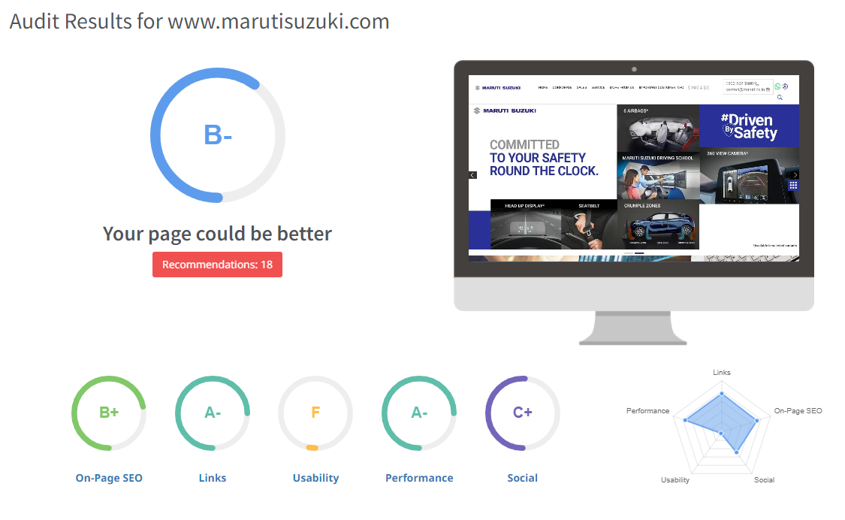
SEO Audit

Slide 17
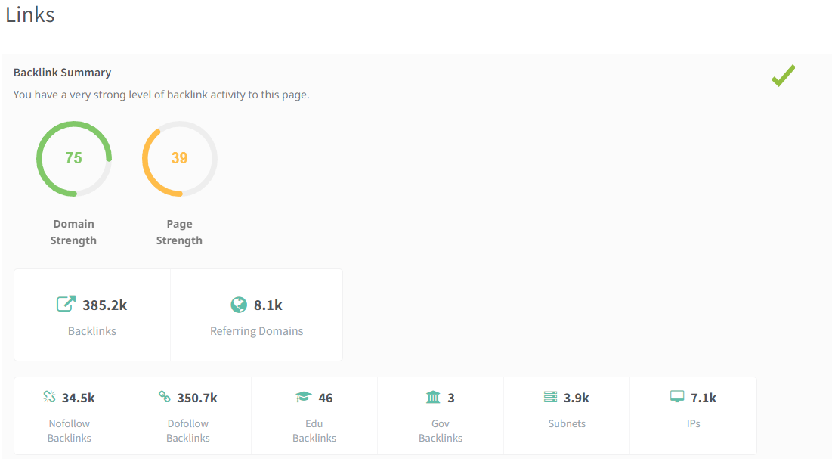

Slide 18
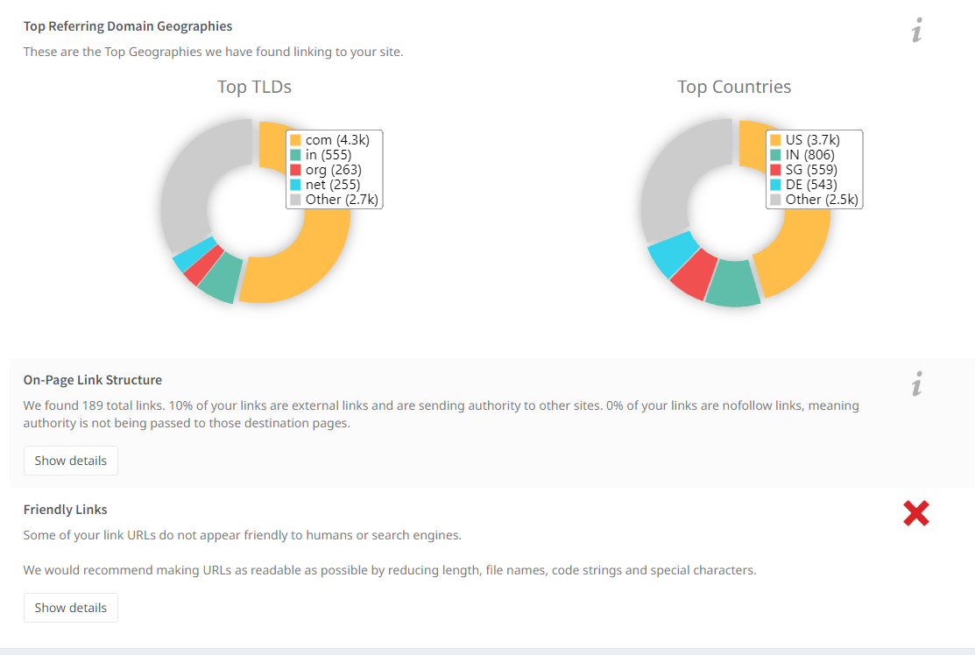

Slide 19
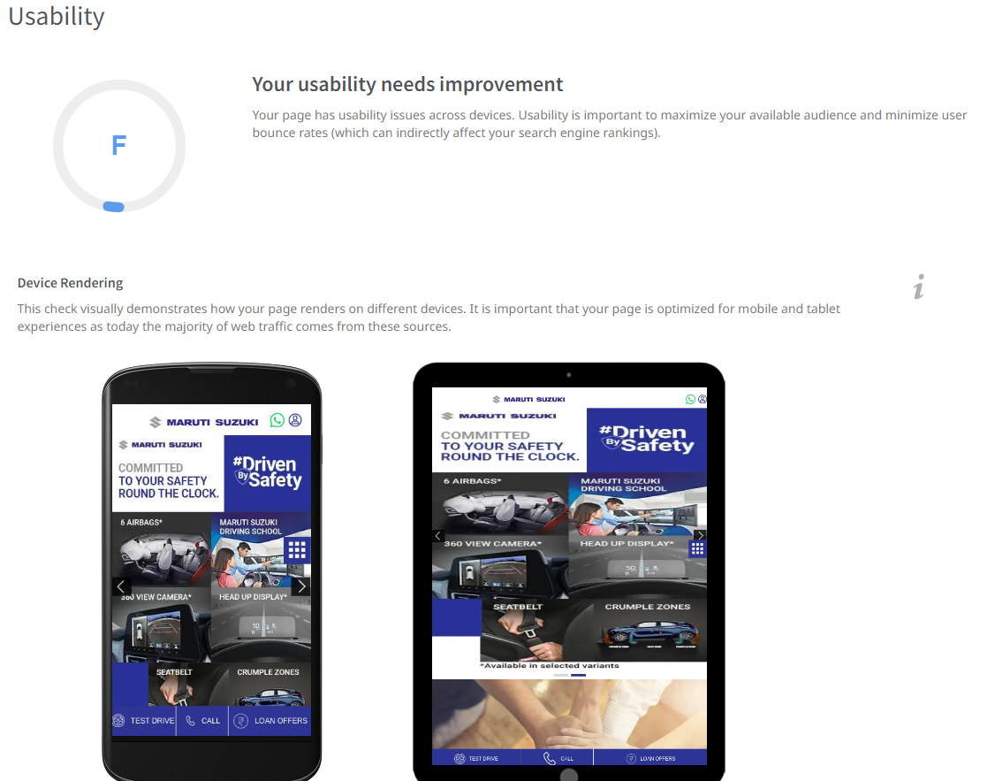

Slide 20
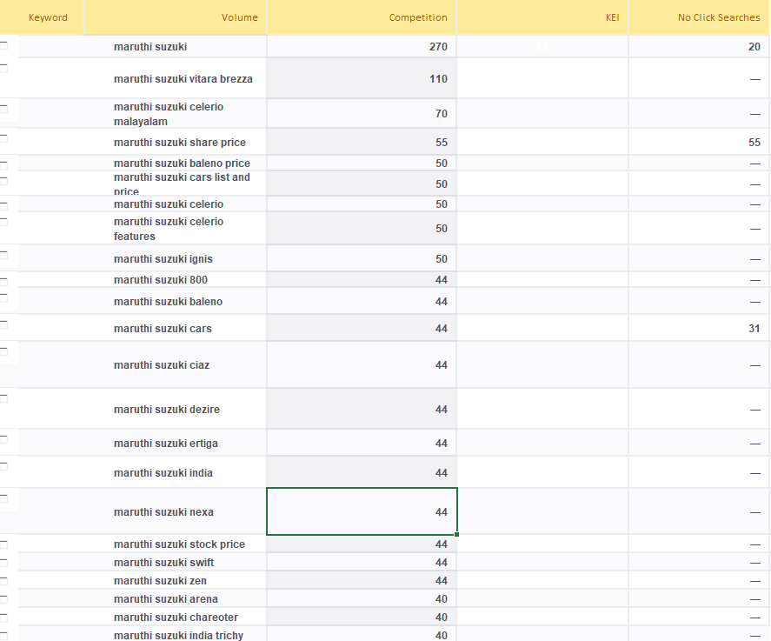
KeyWord Research

Slide 21
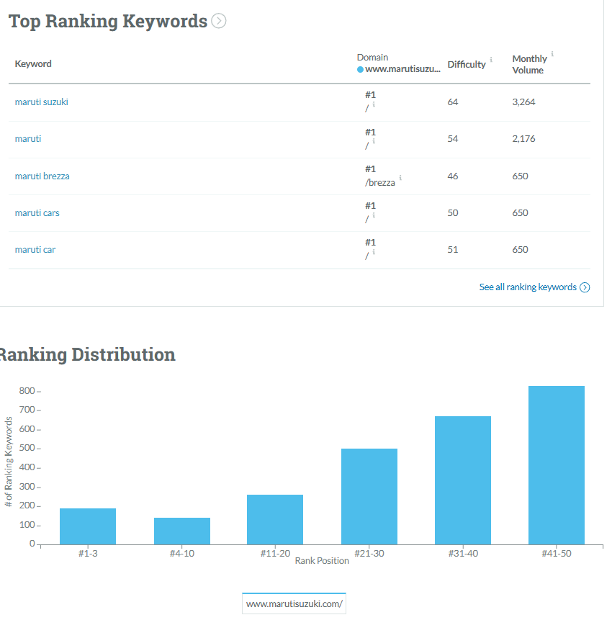
Utilize Keyword Research Tools

Slide 22
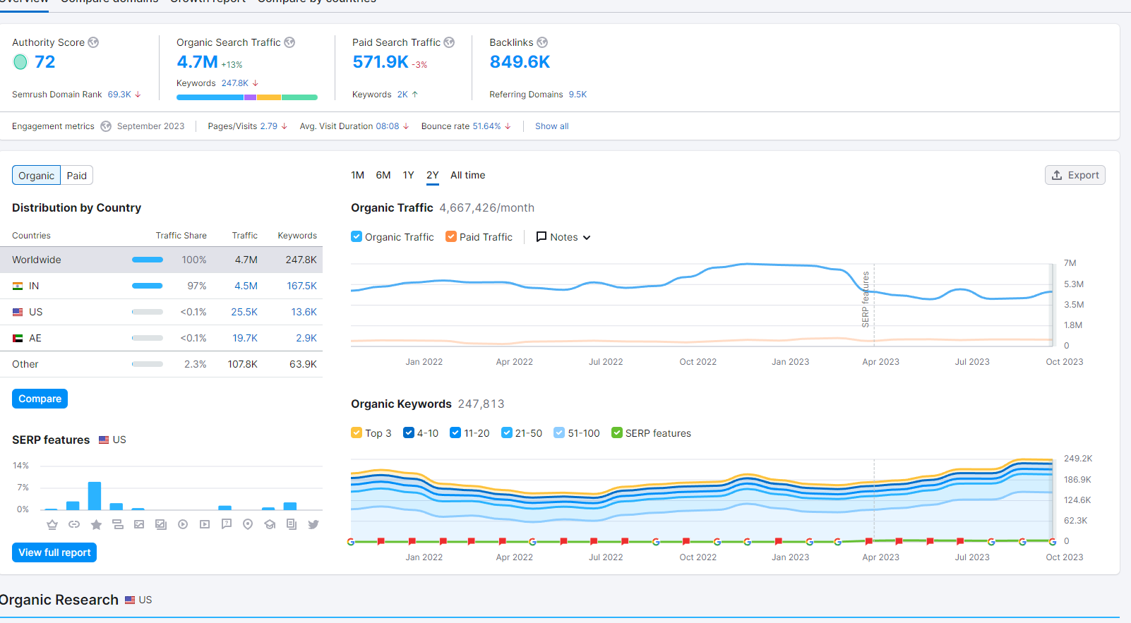

Slide 23
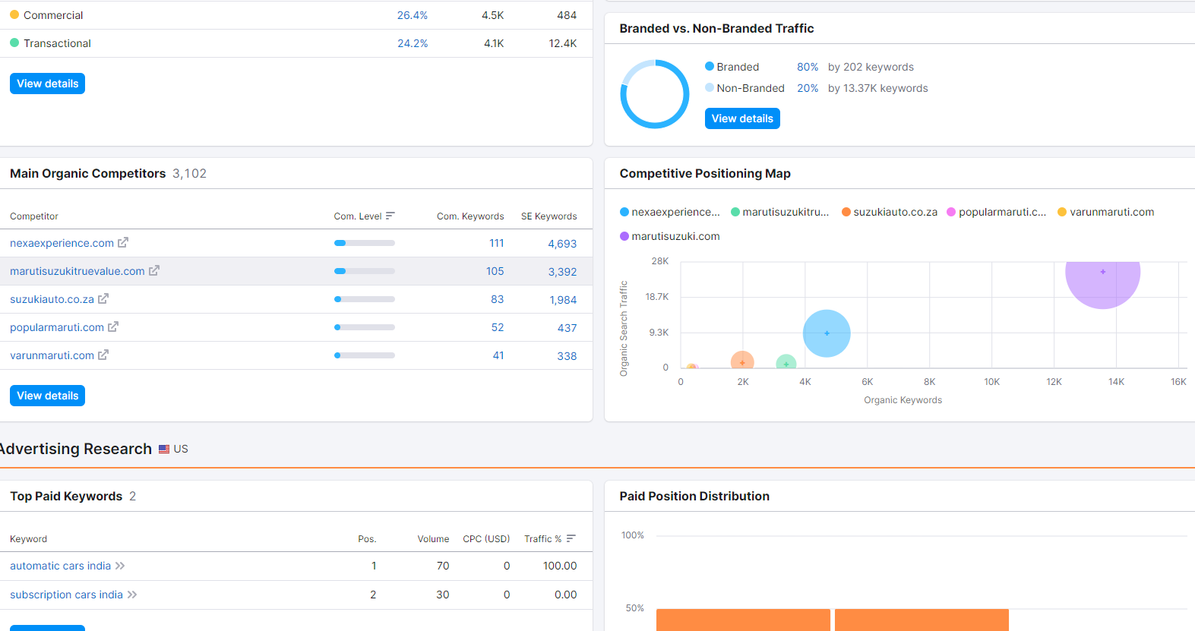

Slide 24
On Page Optimization
Title Tag
"Maruti Suzuki India: Latest Cars, Hatchbacks, Sedans, SUVs"
Meta Description
"Discover top-quality, affordable hatchbacks with Maruti Suzuki. Dive into the world of comfort, safety, and performance."

Slide 25
Chapter Three
03
Content Ideas And Marketing Strategies

Slide 26
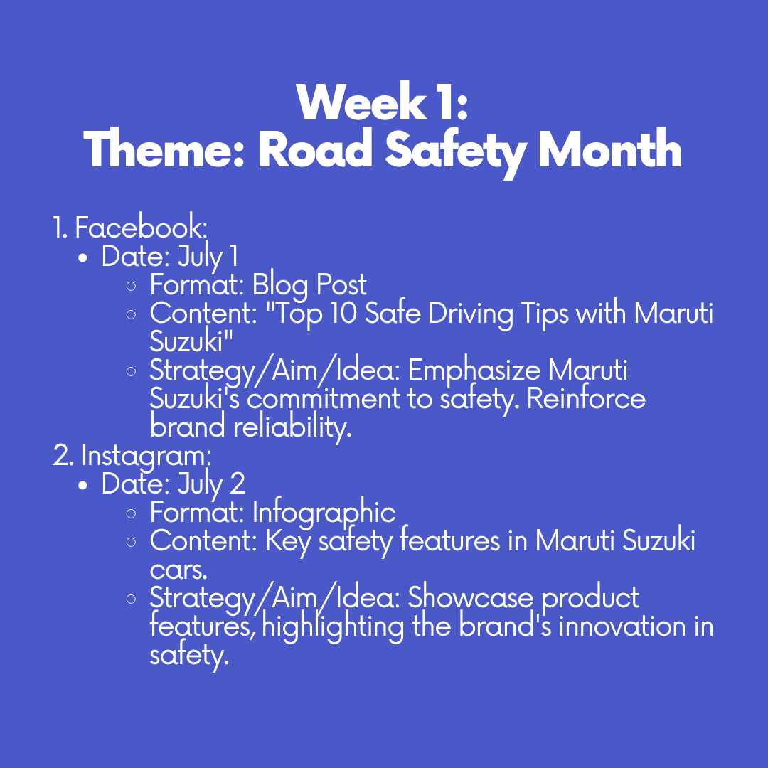
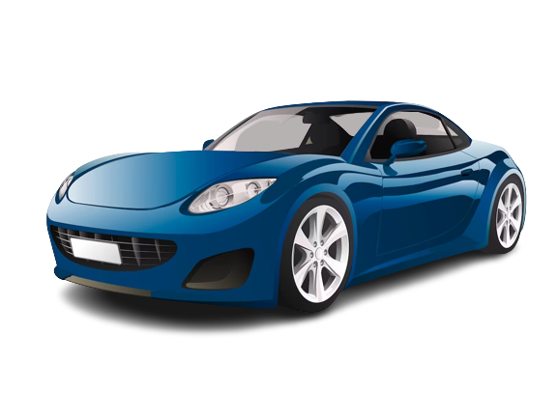
Competitor analysis

Slide 27
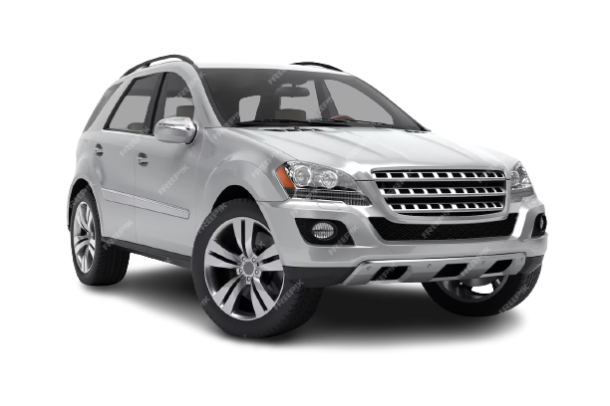
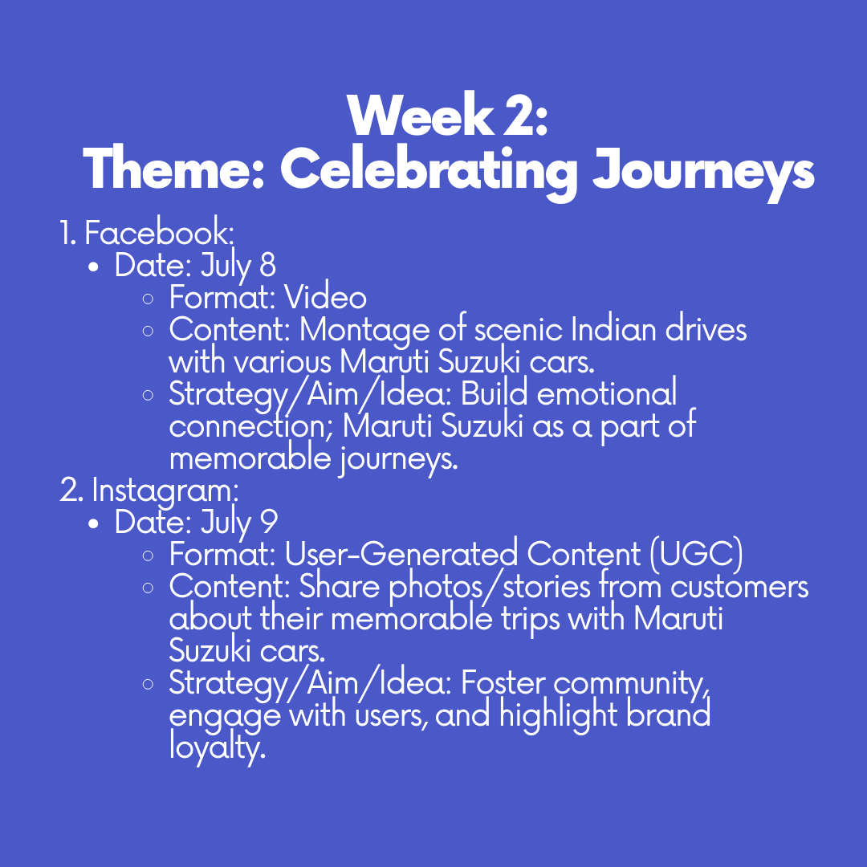

Slide 28
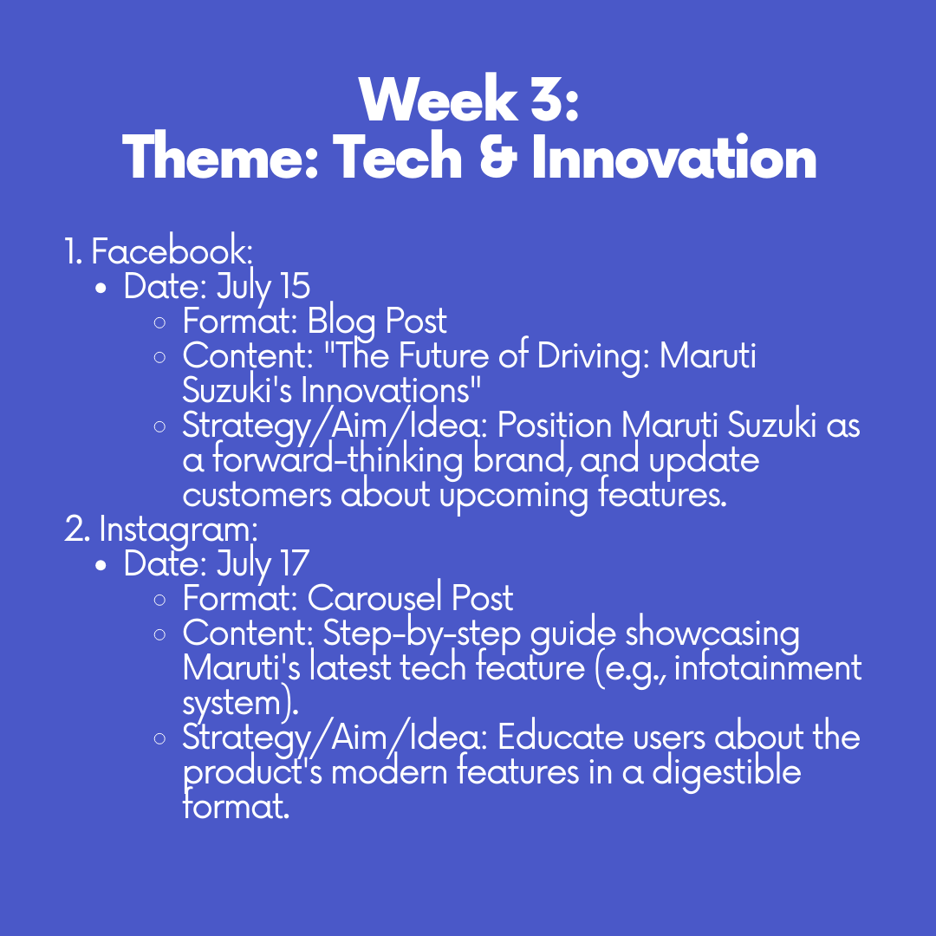
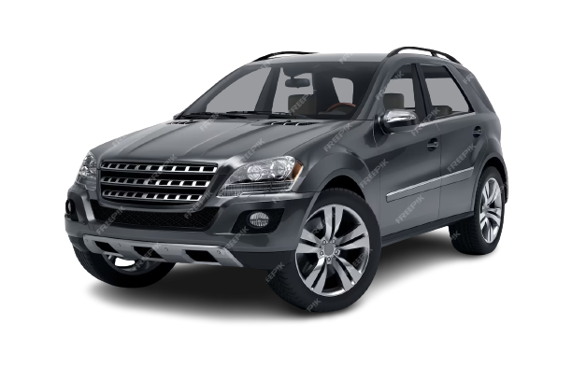

Slide 29
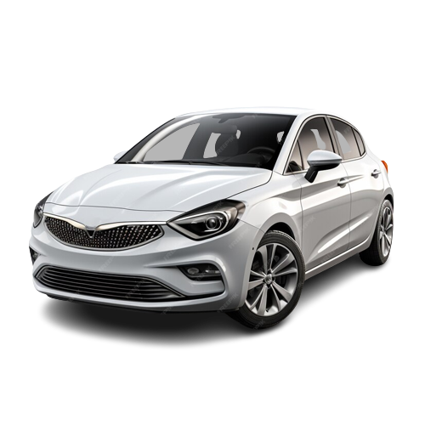
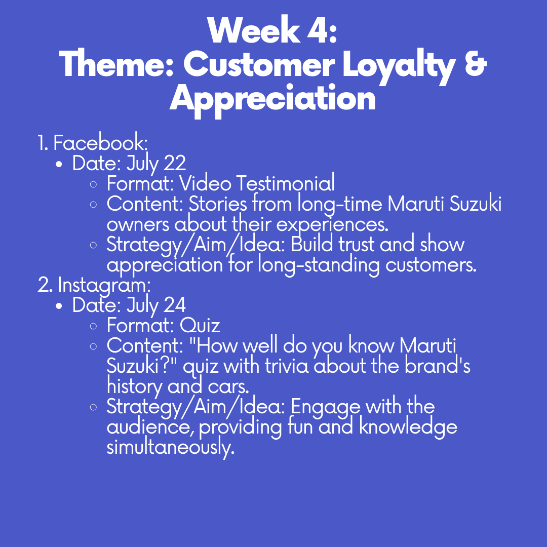

Slide 30



Marketing Strategies
Challenges Encountered
Broad Customer Base
Intense Competition
Changing Consumer Behavior

Slide 31

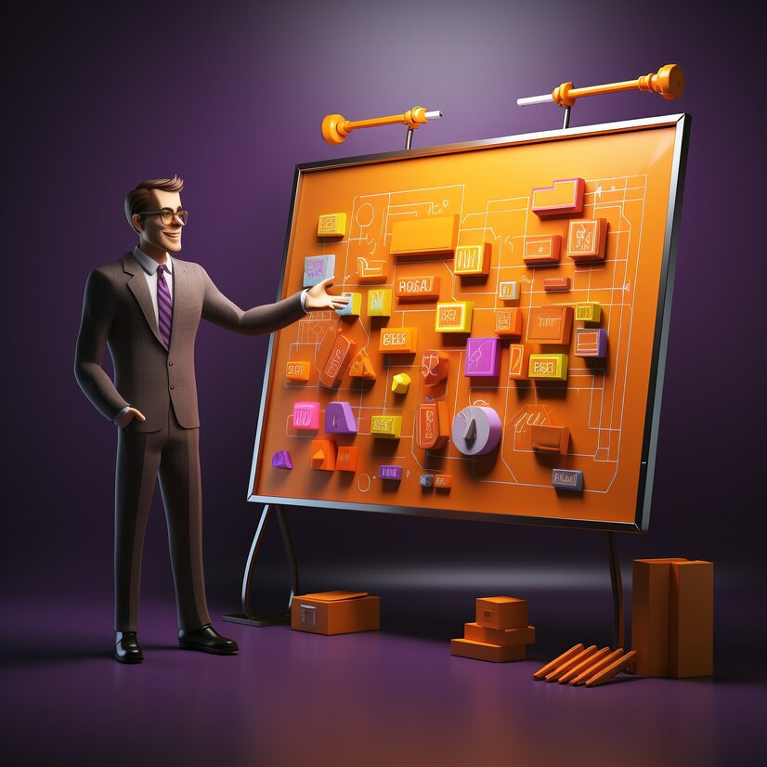

Lessons Learned
Innovation Communication
Consistent Brand Messaging
Feedback Loop

Slide 32
Chapter Four
04
Content Creation And Curation

Slide 33
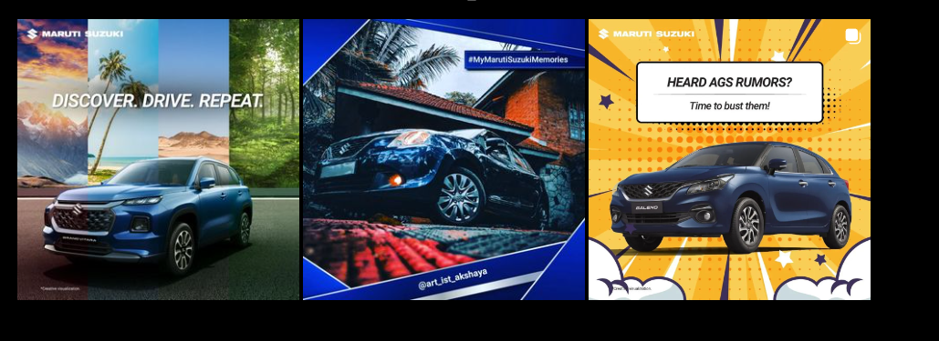
POST CREATION
https://www.instagram.com/maruti_suzuki_theindianmotars/

Slide 34
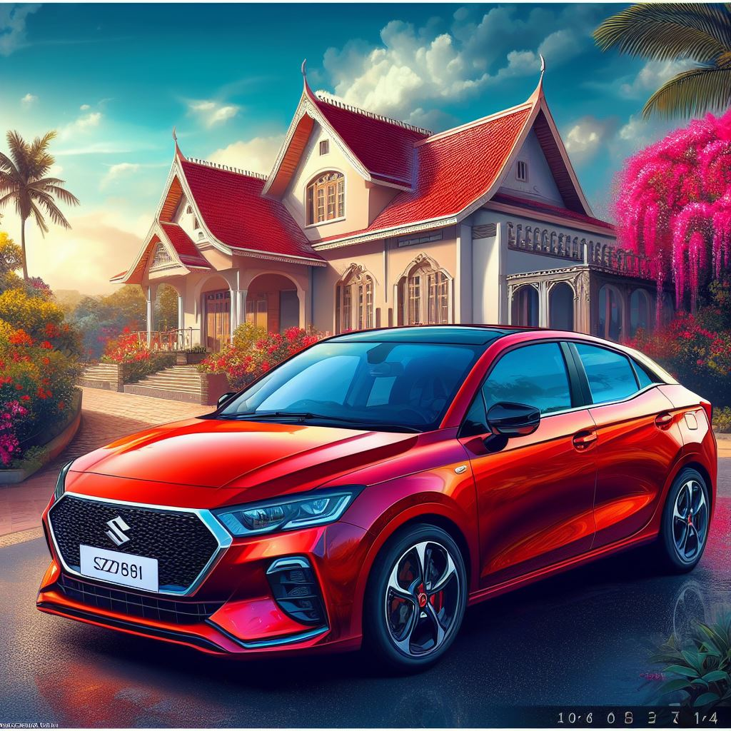
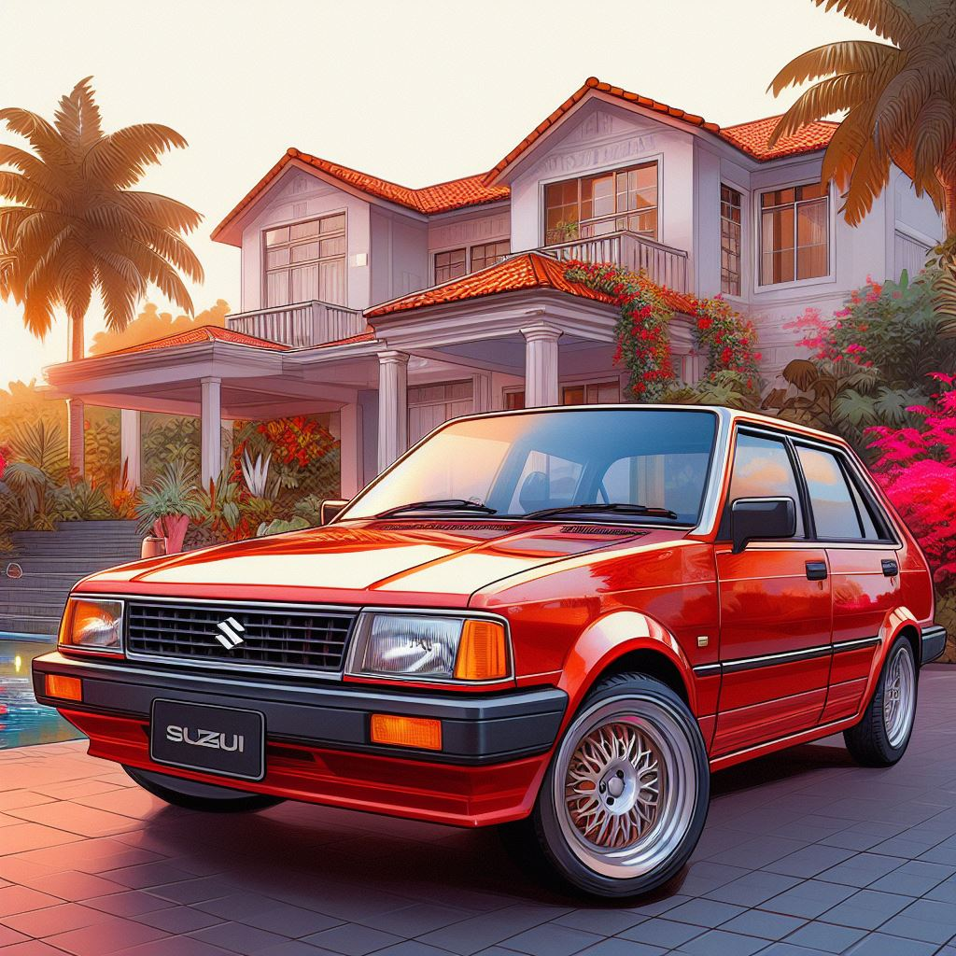
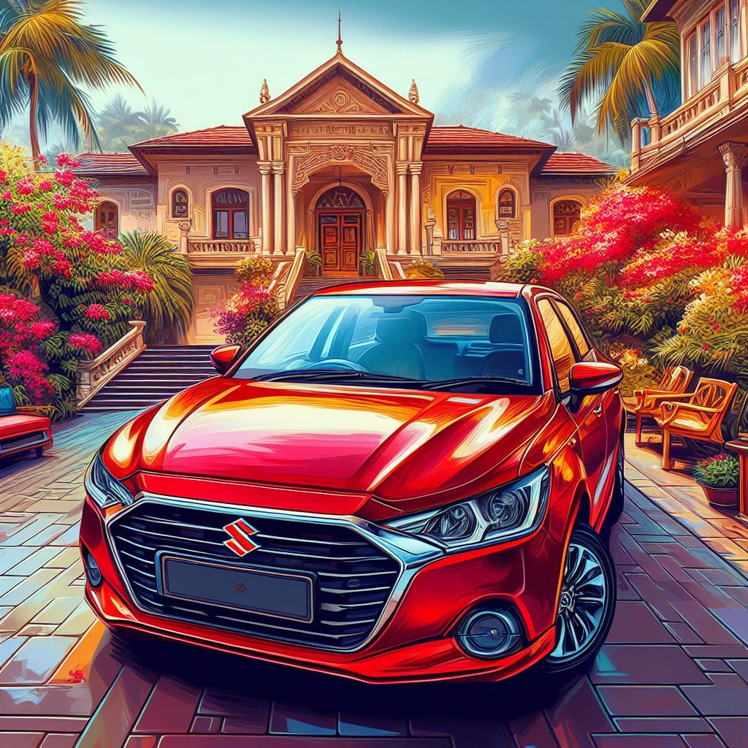
MULTIPLE FORMATS

Slide 35
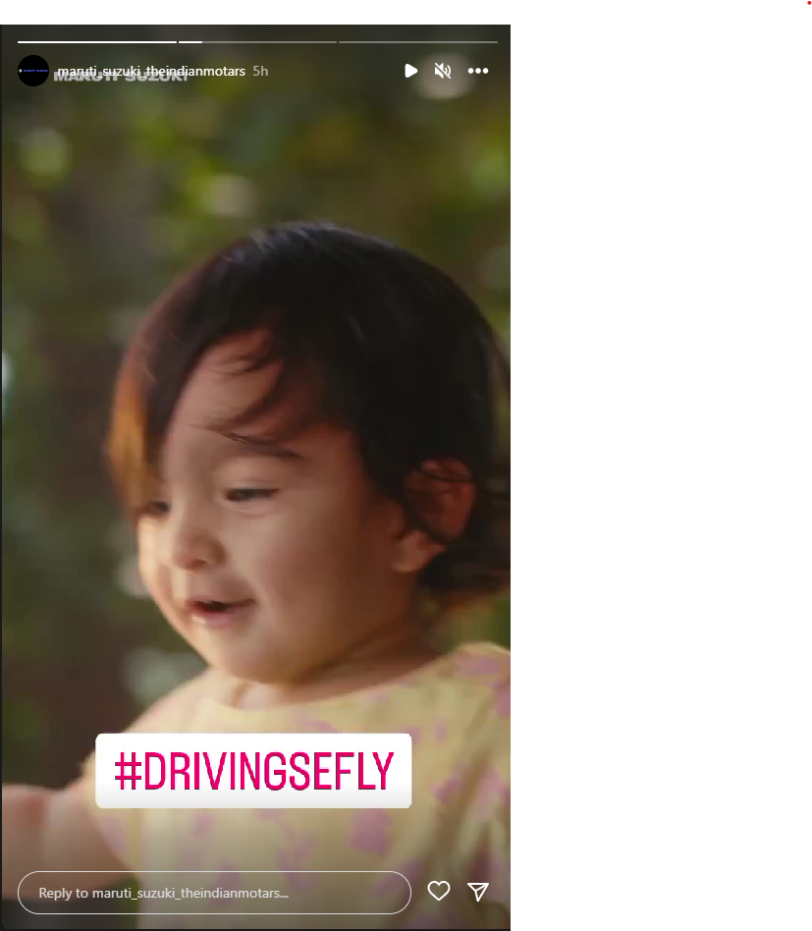
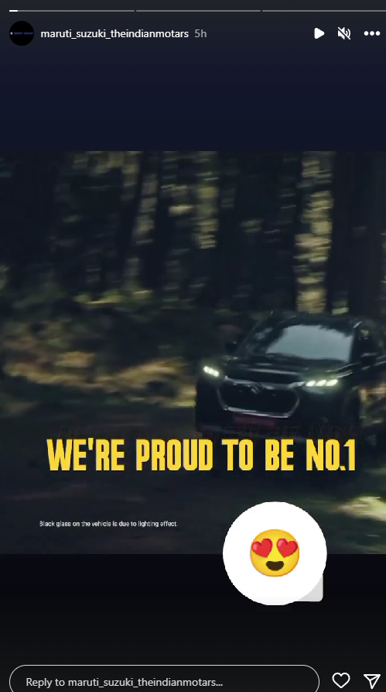
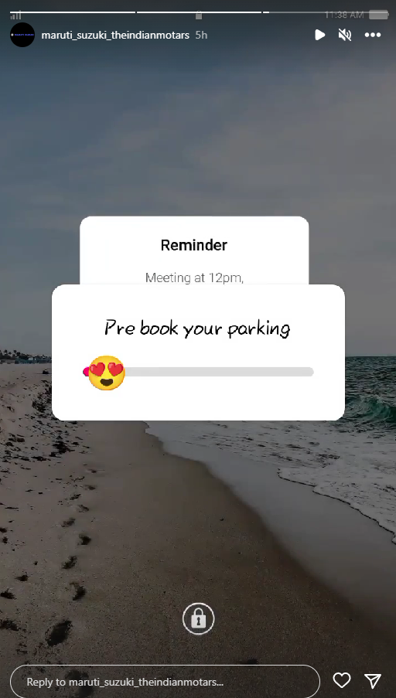

INSTAGRAM STORY

Slide 36

VIDEO STORY
TAP TO SEE THE VIDEO
https://www.instagram.com/maruti_suzuki_theindianmotars/

Slide 37
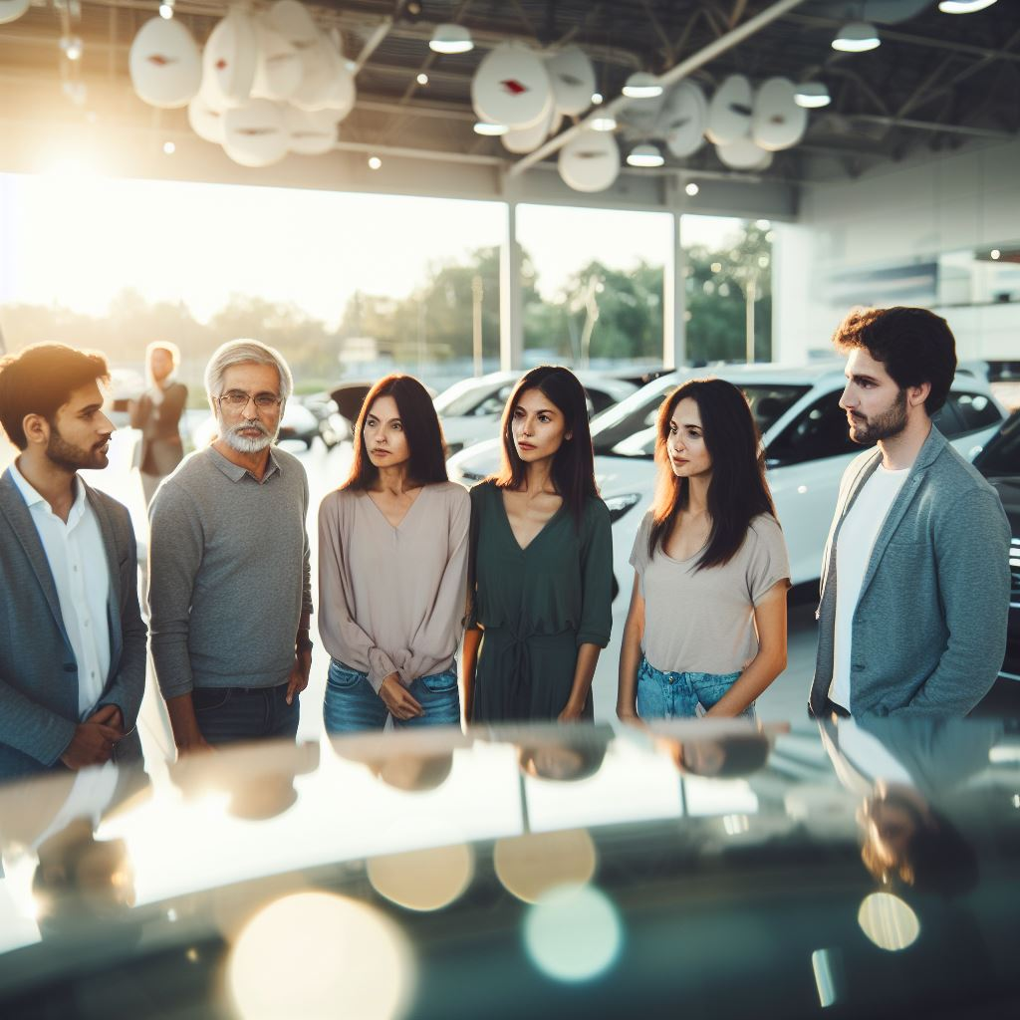
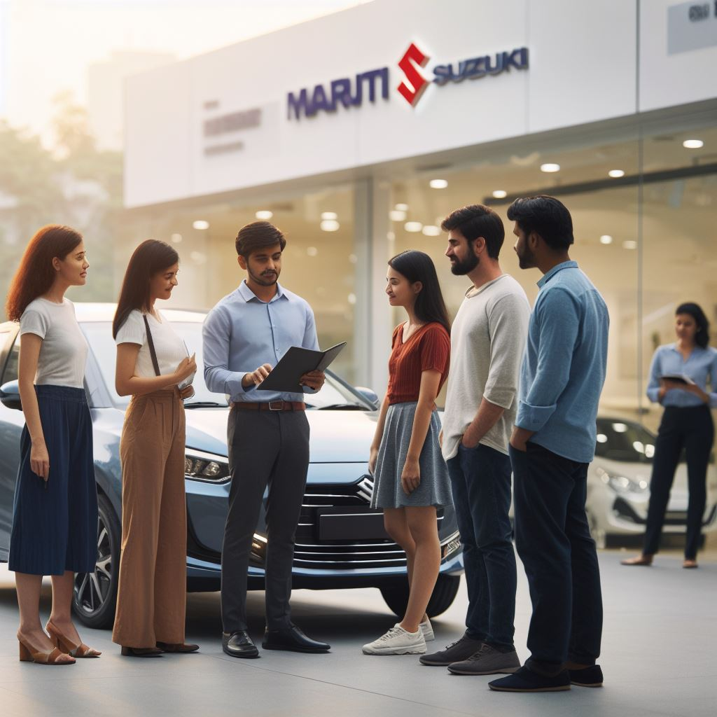
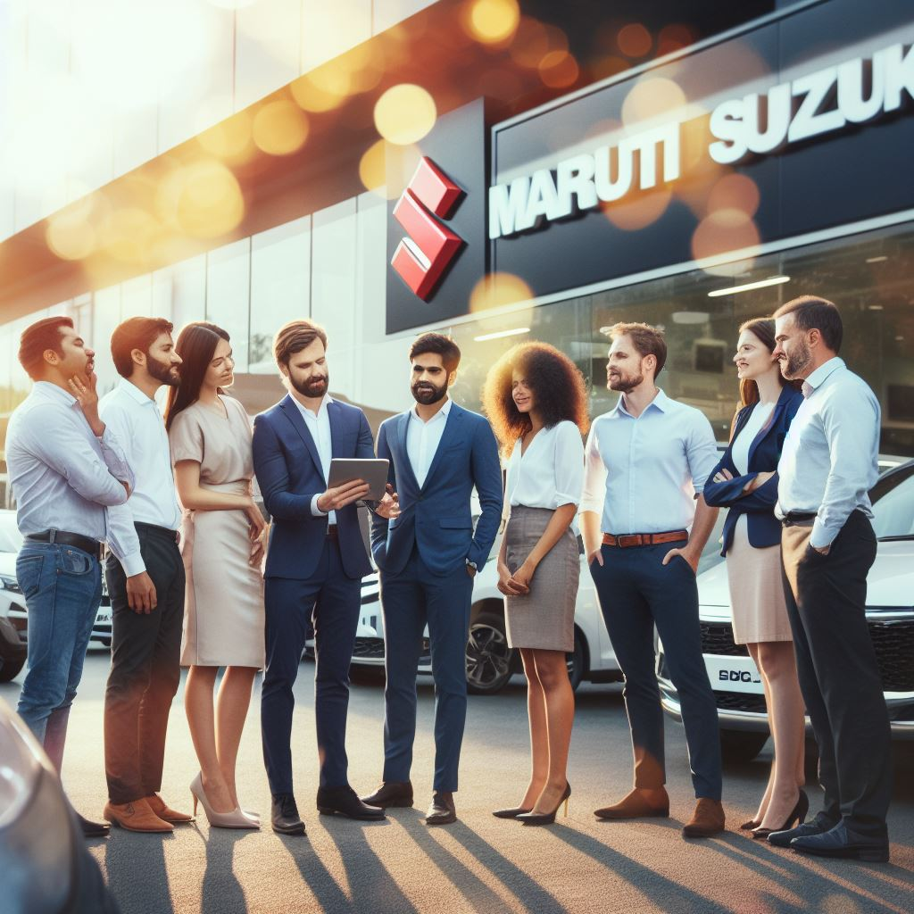
AD POST WITH DESCRIPTION
"Drive the Future, Today."
"Maruti Suzuki – Where Journeys Begin."
"Innovation on Wheels, Passion at Heart."
https://www.instagram.com/maruti_suzuki_theindianmotars/

Slide 38
Conclusion
Thanks for providing is golden opportunity to perform this for Powerpoint presentation and a very thanks for SMARTBRIDGE for providing this internship
Faculty Guid : K.JAGAN MOHAN
Team Members: Golla Sai Narasimha ,katakam Lakshmi Deepak,Vulsi Lavanya ,Kokkirigadda Kezia

